Slide 1
Identifying Synthetic Content
MASTER SLIDE DECK
For presentation
English
Spanish with details
This master slide deck is NOT used for presentation.
Notes:
### References
1. Media Lab at MIT on Detecting Fakes - https://www.media.mit.edu/projects/detect-fakes/overview/
2. Detect Fakes with Kellogg's online tool - https://detectfakes.kellogg.northwestern.edu/
3. CISA Contextualizing Deepfake Threats to Organizations - https://media.defense.gov/2023/Sep/12/2003298925/-1/-1/0/CSI-DEEPFAKE-THREATS.PDF
4. DARPA: Deepfake Defense Tech Ready for Commercialization, Transition - https://www.darpa.mil/news-events/2024-03-14#:~:text=Through%20the%20Semantic%20Forensics%20
5. Scribbr AI Detector - https://www.scribbr.com/ai-detector/
6. Real Bird Image Wins AI Contest - https://www.scientificamerican.com/article/how-this-real-image-won-an-ai-photo-competition/ (Image3-Real-Bird.webp)
7. Facebook Post with AI-Generated Image of Aligators - https://www.facebook.com/story.php?story_fbid=10105216423848582&id=199109935&mibextid=NoJtEM&rdid=3RMz451RwYXWUi4R (Image1-AI-Aligators.jpeg)
8. Reddit Post Believe it or not this image is AI - https://www.reddit.com/r/ChatGPT/comments/1c8u924/believe_it_or_not_this_image_is_ai/ (Image2-AI-Car.webp)
9. Journalist's Car - https://cpj.org/2023/11/photos-israel-hamas-war-takes-unprecedented-toll-on-journalists/ (Image4-Real-Car.jpg)
10. Image of Man Hunting - https://www.reddit.com/r/aiArt/comments/1dkn336/most_realistic_image_ive_prompted/ (Image5-Real-Hunting_Bear.webp)
11. How to Spot a Deepfake - https://time.com/6266606/how-to-spot-deepfake-pope/ (Image6-AI-Pope.png)
12. X Post about Mob attacking Journalist - https://x.com/AbujomaaGaza/status/1798366219546071081 (Image7-Real-Mob_Journalist.jpg)
13. Man Carrying Kids out of Gaza Fact Check - https://factcheck.afp.com/doc.afp.com.33ZJ8WU (Image8-AI-Man_Carrying_Kids.jpg) (Image8-AI-Man_Carrying_Kids.jpeg, Image9-AI-FACTHCHECK-Man_Carrying_Kids.jpeg)
14. Reddit community focused on AI Art - https://www.reddit.com/r/aiArt/
15. In China, AI transformed Ukrainian YouTuber into a Russian - https://www.reuters.com/technology/artificial-intelligence/china-ai-transformed-ukrainian-youtuber-into-russian-2024-06-21/; https://www.threads.net/@reuters/post/C8di0dli_iQ/?xmt=AQGzv6X0VtSp4e0P2Ejo6X-v0Zwm5I4Th7WRWGlMR97rWQ

Slide 2
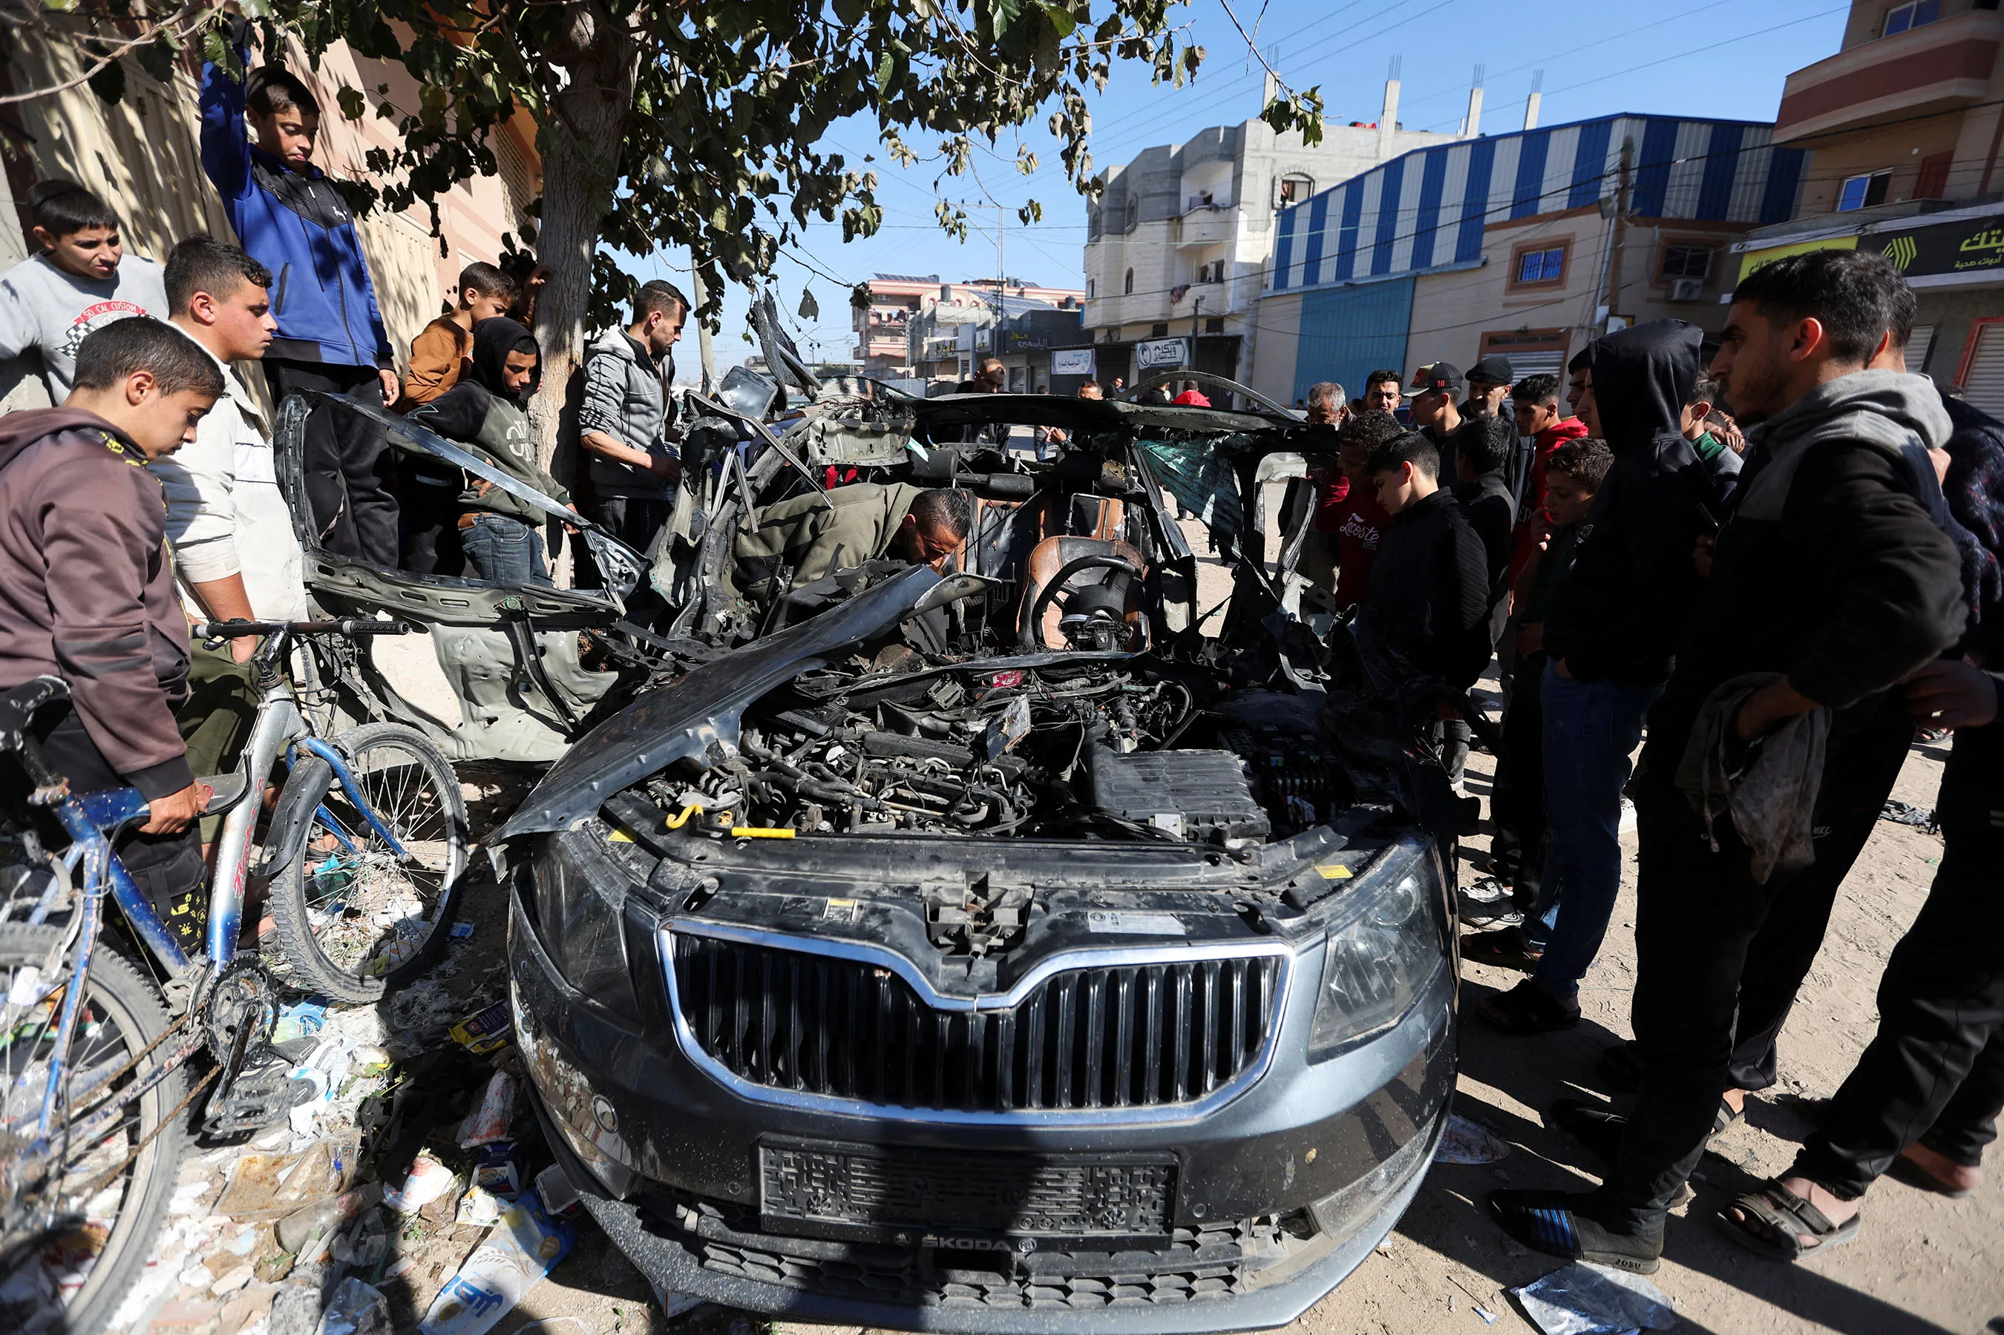
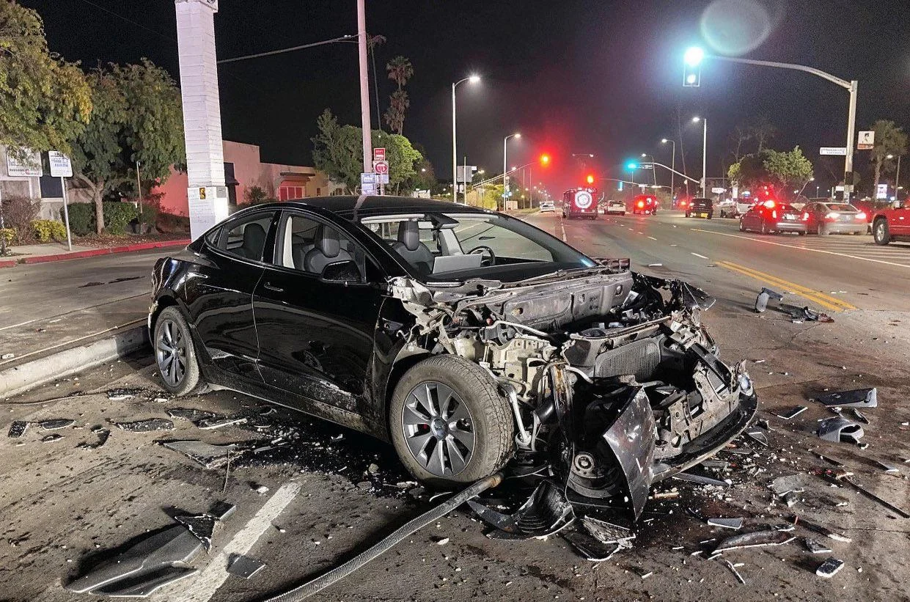
Which is Real?

Slide 3
¿Cual es real?

Slide 4
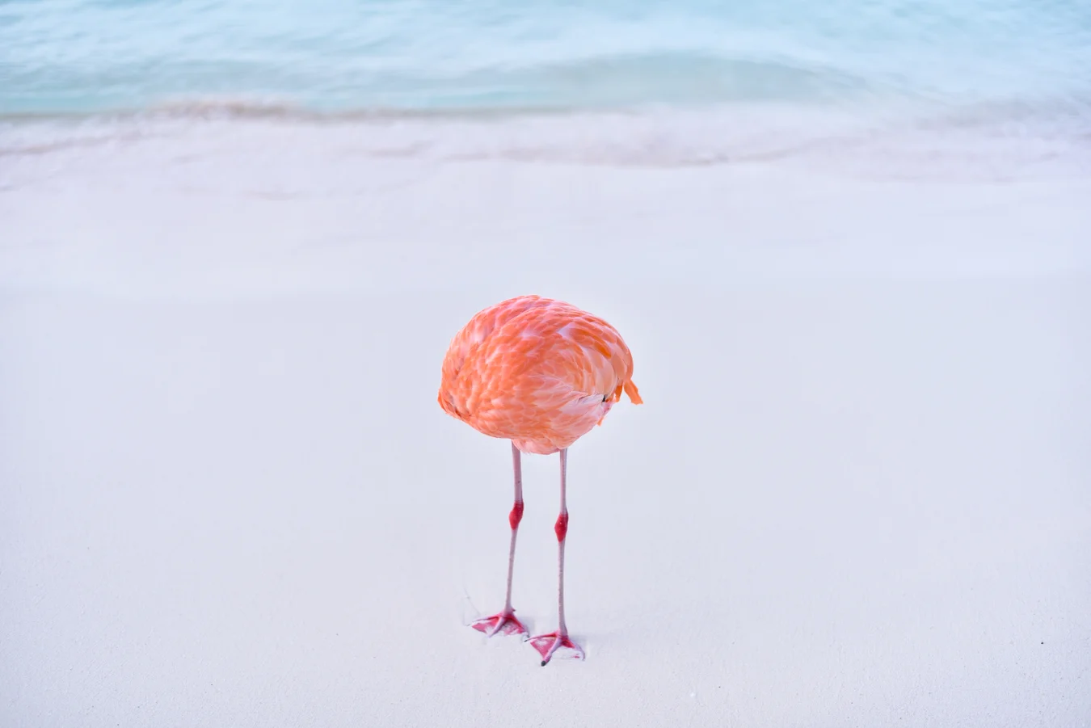
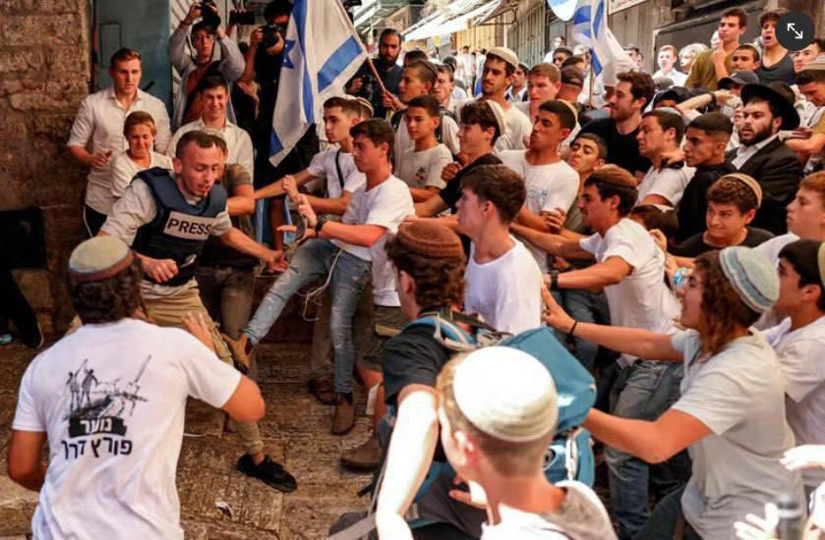
Which is Real?

Slide 5
¿Cual es real?

Slide 6
Intentionally Left Blank
Notes:
This slide is left blank and shall be hidden. When opening the slide deck this slide will help prevent participants from seeing the results

Slide 7
Intentionally Left Blank
Notes:
This slide is left blank and shall be hidden. When opening the slide deck this slide will help prevent participants from seeing the results

Slide 8
Intentionally Left Blank
Notes:
This slide is left blank and shall be hidden. When opening the slide deck this slide will help prevent participants from seeing the results

Slide 9
Intentionally Left Blank
Notes:
This slide is left blank and shall be hidden. When opening the slide deck this slide will help prevent participants from seeing the results

Slide 10
Intentionally Left Blank
Notes:
This slide is left blank and shall be hidden. When opening the slide deck this slide will help prevent participants from seeing the results

Slide 12
Identifying Synthetic Content
Notes:
Start by creating a slide master that is in English. As needed duplicate and translate slides into target language. Color English slides in Yellow and target language slides in white. The example below uses Spanish as a theoretical target language.

Slide 13
Identificación de Contenido Sintético
Notes:
Start by creating a slide master that is in English. As needed duplicate and translate slides into target language. Color English slides in Yellow and target language slides in white. The example below uses Spanish as a theoretical target language.

Slide 14
Lesson Objectives
Identify AI-generated content effectively using specific detection techniques for images, text, and audio.
Lesson is approximately 120 minutes.
Detecting Synthetic with the human eye alone is limited
References:
Media Lab at MIT on Detecting Fakes
Detect Fakes with Kellogg's online tool
CISA Contextualizing Deepfake Threats to Organizations
DARPA: Deepfake Defense Tech Ready for Commercialization, Transition
Notes:
"AI Generated Content is becoming increasingly sophisticated and harder to detect. There will be many situations where it is not possible to determine if content is AI-generated or not. More advanced technical tools and techniques are required to detect AI-generated content."

Slide 15
Objetivos de la Lección
Identifique contenido generado por IA de manera efectiva utilizando técnicas de detección específicas para imágenes, texto y video.
La detección de sintéticos únicamente con el ojo humano es limitada y requiere técnicas técnicas avanzadas.
Referencias:
Media Lab at MIT on Detecting Fakes
Detect Fakes with Kellogg's online tool
CISA Contextualizing Deepfake Threats to Organizations
DARPA: Deepfake Defense Tech Ready for Commercialization, Transition
Notes:
"El contenido generado por IA se está volviendo cada vez más sofisticado y más difícil de detectar. Habrá muchas situaciones en las que no será posible determinar si el contenido es generado por IA o no. Se requieren herramientas y técnicas técnicas más avanzadas para detectar el contenido generado por IA".

Slide 16
Terms Used
Synthetic Content: All-encompassing term for different sorts of automatic and artificial media productions, including video, audio and text manipulation. Synthetic media are commonly based on artificially intelligent software.
Deep Fakes: defined as manipulated or synthetic audio or visual media that seem authentic, and which feature people that appear to say or do something they have never said or done, produced using artificial intelligence techniques, including machine learning and deep learning.
https://www.europarl.europa.eu/RegData/etudes/STUD/2021/690039/EPRS_STU(2021)690039_EN.pdf
Notes:
1. https://www.europarl.europa.eu/RegData/etudes/STUD/2021/690039/EPRS_STU(2021)690039_EN.pdf

Slide 17
Términos utilizados
Synthetic Content: Término que abarca diferentes tipos de producciones de medios automáticos y artificiales, incluida la manipulación de vídeo, audio y texto. Los medios sintéticos suelen basarse en software de inteligencia artificial.[1]
Deep Fakes: medios de audio o visuales manipulados o sintéticos que parecen auténticos y que presentan a personas que parecen decir o hacer algo que nunca han dicho o hecho, producidos utilizando técnicas de inteligencia artificial, incluido el aprendizaje automático y el aprendizaje profundo[1]
Notes:
1. https://www.europarl.europa.eu/RegData/etudes/STUD/2021/690039/EPRS_STU(2021)690039_EN.pdf

Slide 18
Memorize Synthetic Check: Human Image
Context of the scene
Hands and limbs of people
Face and facial features
Clothes and items
Notes:
Give students time to memorize this on their own. The focus is on memorization not yet on the explaining of each of these.

Slide 19
Proceso de detección sintética: Imagen Humana
Contexto de la escena
Manos y extremidades de personas
Rostro y rasgos faciales.
Ropa y artículos
Notes:
Give students time to memorize this on their own. The focus is on memorization not yet on the explaining of each of these.

Slide 20
Memorize Structure Image Check
Context of the scene
Structural Consistency
Material Texture
Lighting and Shadows
Perspective and Geometry
Repeating or Missing Elements
Nonsensical Object Placement
Anomalies in Common Patterns
Notes:
Give students time to memorize this on their own. The focus is on memorization not yet on the explaining of each of these.

Slide 21
Proceso de detección sintética: Estructuras
Contexto de la escena
Consistencia estructural
Textura del material
Iluminación y sombras
Perspectiva y Geometría
Repetición en detalle
Elementos faltantes
Colocación de objetos sin sentido
Continuidad interrumpida
Anomalías en patrones comunes
Notes:
Give students time to memorize this on their own. The focus is on memorization not yet on the explaining of each of these.

Slide 22
Synthetic Check: Human Image
Context of the scene
Hands and limbs of people
Face and facial features
Clothes and items

Slide 23
Proceso de detección sintética: Imagen Humana
Contexto de la escena
Manos y extremidades de personas
Rostro y rasgos faciales.
Ropa y artículos

Slide 24
Structure Image Check
Context of the scene
Structural Consistency
Material Texture
Lighting and Shadows
Perspective and Geometry
Repeating or Missing Elements
Nonsensical Object Placement
Anomalies in Common Patterns

Slide 25
Proceso de detección sintética: Estructuras
Contexto de la escena
Consistencia estructural
Textura del material
Iluminación y sombras
Perspectiva y Geometría
Repetición en detalle
Elementos faltantes
Colocación de objetos sin sentido
Continuidad interrumpida
Anomalías en patrones comunes

Slide 26
Structure Image Check
Context of the scene
Structural Consistency
Material Texture
Lighting and Shadows
Perspective and Geometry
Repeating or Missing Elements
Nonsensical Object Placement
Anomalies in Common Patterns

Slide 27
Proceso de detección sintética: Estructuras
Contexto de la escena
Consistencia estructural
Textura del material
Iluminación y sombras
Perspectiva y Geometría
Repetición en detalle
Elementos faltantes
Colocación de objetos sin sentido
Continuidad interrumpida
Anomalías en patrones comunes

Slide 28
Synthetic Check: Human Image
Context of the scene
Hands and limbs of people
Face and facial features
Clothes and items

Slide 29
Proceso de detección sintética: Imagen Humana
Contexto de la escena
Manos y extremidades de personas
Rostro y rasgos faciales.
Ropa y artículos

Slide 30
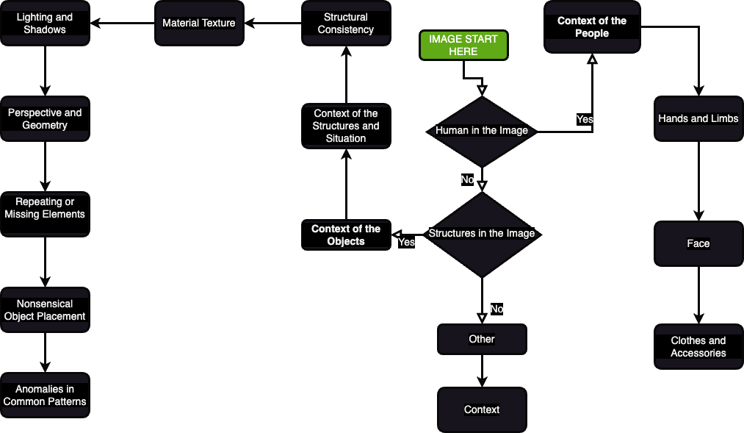

Slide 31
Define Synthetic Check: Human Image
Context of the scene
Hands and limbs of people
Face and facial features
Clothes and items

Slide 32
Proceso de detección sintética: Imagen Humana
Contexto de la escena
Manos y extremidades de personas
Rostro y rasgos faciales.
Ropa y artículos

Slide 33
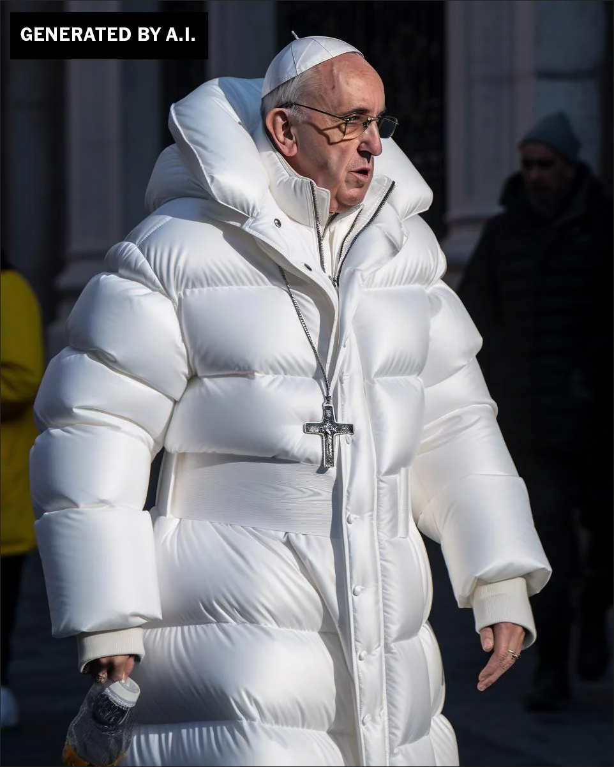
Human Images
What are the steps ?

Slide 34
Imagen Humana
¿ ?

Slide 35
Human Images: Context
Logic and Context of the Scene

Slide 36
Imagen Humana: Context
Contexto de la escena

Slide 37
Human Images: Hands and Limbs
Pay Attention to the Hands and Fingers

Slide 38
Imagen Humana : Hands and Limbs
Manos y extremidades de personas

Slide 39
Human Images: Face
Pay Attention to the Face
Pay attention to the cheeks and forehead
Pay attention to the eyes and eyebrows
Pay attention to the glasses
Pay attention to facial hair
Pay attention to facial moles

Slide 40
Human Images: Face
Presta atención a la cara
Presta atención a las mejillas y la frente.
Presta atención a los ojos y las cejas.
Presta atención a las gafas.
Presta atención al vello facial
Presta atención a los lunares faciales.

Slide 41
Human Images: Clothing
Pay attention to the clothes
Warped Items
Missing and Extra items
Perspective and Geometry
Repetition in Detail
Material Texture

Slide 42
Human Images: Clothing
Presta atención a la ropa.
Artículos deformados
Artículos faltantes y adicionales
Perspectiva y Geometría
Repetición en detalle
Textura del material

Slide 43
Human Image Check
Context of the scene
Hands and limbs of people
Face and facial features
Clothes and items

Slide 44
Proceso de detección sintética: Imagen Humana
Context of the scene
Hands and limbs of people
Face and facial features
Clothes and items

Slide 45
Human Image Check
Context of the scene
Hands and limbs of people
Face and facial features
Clothes and items

Slide 46
Proceso de detección sintética: Imagen Humana
Contexto de la escena
Manos y extremidades de personas
Rostro y rasgos faciales.
Ropa y artículos

Slide 47
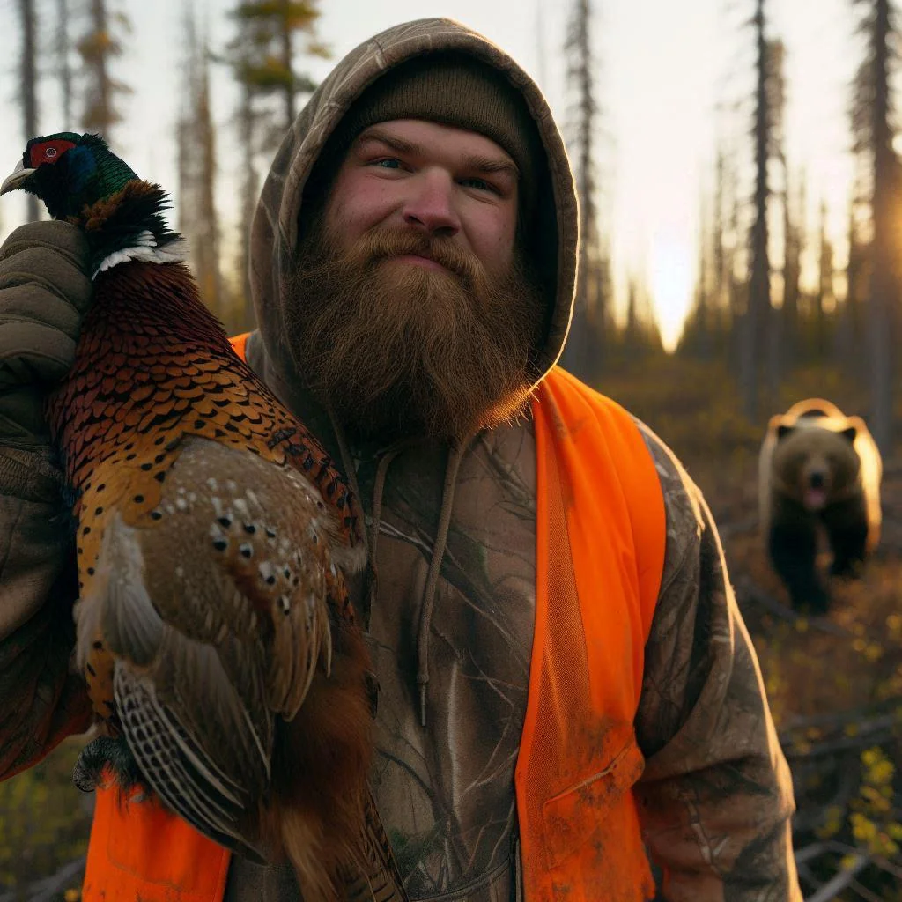
Human Images: Check On Learning
What do you notice?
Notes:
The scene, consider the bear sneaking up on him (bears can be noisy) See the extra drawstring on the hoody See the texture of the Visibility vest which is very different than outdoor gear

Slide 48
Proceso de detección sintética: Imagen Humana: Practica
¿ Qué Percibes?
Notes:
The scene, consider the bear sneaking up on him (bears can be noisy) See the extra drawstring on the hoody See the texture of the Visibility vest which is very different than outdoor gear

Slide 49
Human Images: Check On Learning
What do you notice?
Notes:
The scene, consider the bear sneaking up on him (bears can be noisy) See the extra drawstring on the hoody See the texture of the Visibility vest which is very different than outdoor gear

Slide 50
Proceso de detección sintética: Imagen Humana: Practica
Notes:
The scene, consider the bear sneaking up on him (bears can be noisy) See the extra drawstring on the hoody See the texture of the Visibility vest which is very different than outdoor gear

Slide 51
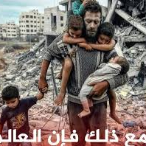
Human Images: Check On Learning
What do you notice?
Notes:
Notice the hands
Notice how long the boys shoulder would need to be
Notice the toes
Notice the dark figure in the background

Slide 52
Proceso de detección sintética: Imagen Humana: Practica
¿Qué Percibes?
Notes:
Notice the hands
Notice how long the boys shoulder would need to be
Notice the toes
Notice the dark figure in the background

Slide 53
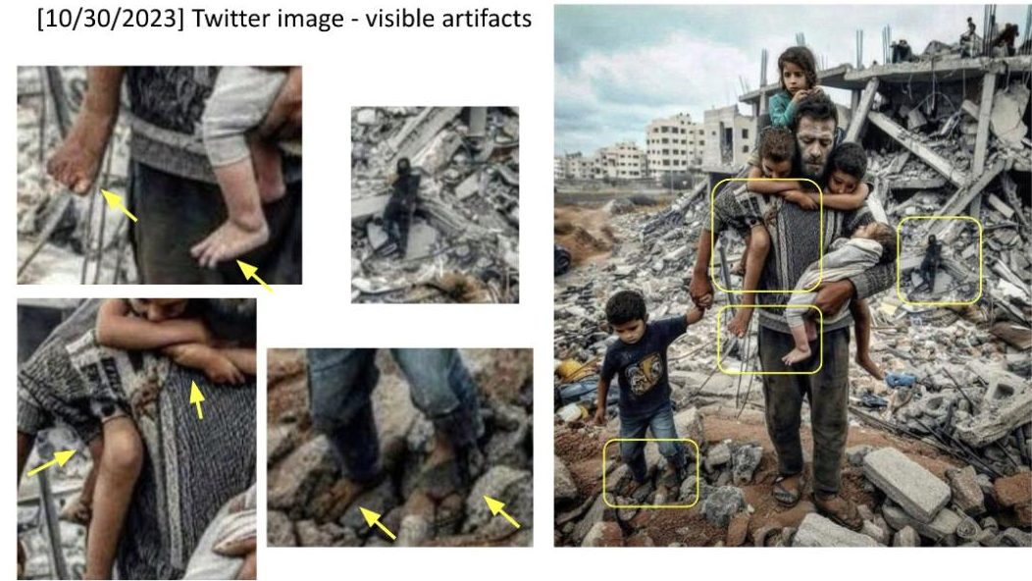

Slide 54
Structure Image Check
Context of the scene
Structural Consistency
Material Texture
Lighting and Shadows
Perspective and Geometry
Repeating or Missing Elements
Nonsensical Object Placement
Anomalies in Common Patterns

Slide 55
Proceso de detección sintética: Estructuras
Contexto de la escena
Consistencia estructural
Textura del material
Iluminación y sombras
Perspectiva y Geometría
Repetición en detalle
Elementos faltantes
Colocación de objetos sin sentido
Continuidad interrumpida
Anomalías en patrones comunes

Slide 56
Structure Image
What do you notice?
Notes:
the lanes are nonsensical
The green light on top
The Light posts seem odd
The signs and language seem nonsensical
Some of the cars have no tires
This is supposed to be a tesla but the wheels are off
The windshield seems to disappear in some areas.

Slide 57
Imagen de una escena
¿ Qué Percibes?
Notes:
the lanes are nonsensical
The green light on top
The Light posts seem odd
The signs and language seem nonsensical
Some of the cars have no tires
This is supposed to be a tesla but the wheels are off
The windshield seems to disappear in some areas.

Slide 58
Structure Image
Structural Consistency
Perspective and Geometry
Repetition in Detail
Nonsensical Object Placement
Anomalies in Common Patterns

Slide 59
Imagen de una escena
Consistencia estructural
Perspectiva y Geometría
Repetición en detalle
Colocación de objetos sin sentido
Anomalías en patrones communes

Slide 60
Structure Image
Structural Consistency
Perspective and Geometry
Repetition in Detail
Nonsensical Object Placement
Anomalies in Common Patterns

Slide 61
Imagen de una escena
Consistencia estructural
Perspectiva y Geometría
Repetición en detalle
Colocación de objetos sin sentido
Anomalías en patrones communes

Slide 62
Structure Image
Structural Consistency

Slide 63
Imagen de una escena
Consistencia estructural

Slide 64
Structure Image: Check On Learning
Context of the scene
Structural Consistency
Material Texture
Lighting and Shadows
Perspective and Geometry
Repeating or Missing Elements
Nonsensical Object Placement
Anomalies in Common Patterns

Slide 65
Proceso de detección sintética: Estructuras
Context of the scene
Structural Consistency
Material Texture
Lighting and Shadows
Perspective and Geometry
Repetition in Detail
Missing Elements
Nonsensical Object Placement
Disrupted Continuity
Anomalies in Common Patterns

Slide 66
Structure Image Check
Context of the scene
Structural Consistency
Material Texture
Lighting and Shadows
Perspective and Geometry
Repeating or Missing Elements
Nonsensical Object Placement
Anomalies in Common Patterns

Slide 67
Proceso de detección sintética: Estructuras
Contexto de la escena
Consistencia estructural
Textura del material
Iluminación y sombras
Perspectiva y Geometría
Repetición en detalle
Elementos faltantes
Colocación de objetos sin sentido
Continuidad interrumpida
Anomalías en patrones comunes

Slide 68
Synthetic Video Check: Practical Exercise
Context of the scene
Structural Consistency
Material Texture
Develop your Techniques…
Search online for possible deepfake videos that have been in the news
Analyze the video
Determine your own TTP for detecting synthetic videos
Present TTPs

Slide 69
Comprobación de vídeo sintético: ejercicio práctico
Contexto de la escena
Consistencia estructural
Textura del material
Continuar con Técnicas…
Busque videos deepfake que hayan aparecido en las noticias
Analiza el vídeo
Determina tus propias técnicas para detectar vídeos sintéticos.
Presentar técnicas de detección de vídeo sintético.

Slide 70
References
1. Media Lab at MIT on Detecting Fakes - https://www.media.mit.edu/projects/detect-fakes/overview/
2. Detect Fakes with Kellogg's online tool - https://detectfakes.kellogg.northwestern.edu/
3. CISA Contextualizing Deepfake Threats to Organizations - https://media.defense.gov/2023/Sep/12/2003298925/-1/-1/0/CSI-DEEPFAKE-THREATS.PDF
4. DARPA: Deepfake Defense Tech Ready for Commercialization, Transition - https://www.darpa.mil/news-events/2024-03-14#:~:text=Through%20the%20Semantic%20Forensics%20
Notes:
### References
1. Media Lab at MIT on Detecting Fakes - https://www.media.mit.edu/projects/detect-fakes/overview/
2. Detect Fakes with Kellogg's online tool - https://detectfakes.kellogg.northwestern.edu/
3. CISA Contextualizing Deepfake Threats to Organizations - https://media.defense.gov/2023/Sep/12/2003298925/-1/-1/0/CSI-DEEPFAKE-THREATS.PDF
4. DARPA: Deepfake Defense Tech Ready for Commercialization, Transition - https://www.darpa.mil/news-events/2024-03-14#:~:text=Through%20the%20Semantic%20Forensics%20
5. Scribbr AI Detector - https://www.scribbr.com/ai-detector/
6. Real Bird Image Wins AI Contest - https://www.scientificamerican.com/article/how-this-real-image-won-an-ai-photo-competition/ (Image3-Real-Bird.webp)
7. Facebook Post with AI-Generated Image of Aligators - https://www.facebook.com/story.php?story_fbid=10105216423848582&id=199109935&mibextid=NoJtEM&rdid=3RMz451RwYXWUi4R (Image1-AI-Aligators.jpeg)
8. Reddit Post Believe it or not this image is AI - https://www.reddit.com/r/ChatGPT/comments/1c8u924/believe_it_or_not_this_image_is_ai/ (Image2-AI-Car.webp)
9. Journalist's Car - https://cpj.org/2023/11/photos-israel-hamas-war-takes-unprecedented-toll-on-journalists/ (Image4-Real-Car.jpg)
10. Image of Man Hunting - https://www.reddit.com/r/aiArt/comments/1dkn336/most_realistic_image_ive_prompted/ (Image5-Real-Hunting_Bear.webp)
11. How to Spot a Deepfake - https://time.com/6266606/how-to-spot-deepfake-pope/ (Image6-AI-Pope.png)
12. X Post about Mob attacking Journalist - https://x.com/AbujomaaGaza/status/1798366219546071081 (Image7-Real-Mob_Journalist.jpg)
13. Man Carrying Kids out of Gaza Fact Check - https://factcheck.afp.com/doc.afp.com.33ZJ8WU (Image8-AI-Man_Carrying_Kids.jpg) (Image8-AI-Man_Carrying_Kids.jpeg, Image9-AI-FACTHCHECK-Man_Carrying_Kids.jpeg)
14. Reddit community focused on AI Art - https://www.reddit.com/r/aiArt/
15. In China, AI transformed Ukrainian YouTuber into a Russian - https://www.reuters.com/technology/artificial-intelligence/china-ai-transformed-ukrainian-youtuber-into-russian-2024-06-21/; https://www.threads.net/@reuters/post/C8di0dli_iQ/?xmt=AQGzv6X0VtSp4e0P2Ejo6X-v0Zwm5I4Th7WRWGlMR97rWQ

Slide 71
Referencias
1. Media Lab at MIT on Detecting Fakes - https://www.media.mit.edu/projects/detect-fakes/overview/
2. Detect Fakes with Kellogg's online tool - https://detectfakes.kellogg.northwestern.edu/
3. CISA Contextualizing Deepfake Threats to Organizations - https://media.defense.gov/2023/Sep/12/2003298925/-1/-1/0/CSI-DEEPFAKE-THREATS.PDF
4. DARPA: Deepfake Defense Tech Ready for Commercialization, Transition - https://www.darpa.mil/news-events/2024-03-14#:~:text=Through%20the%20Semantic%20Forensics%20
Notes:
### References
1. Media Lab at MIT on Detecting Fakes - https://www.media.mit.edu/projects/detect-fakes/overview/
2. Detect Fakes with Kellogg's online tool - https://detectfakes.kellogg.northwestern.edu/
3. CISA Contextualizing Deepfake Threats to Organizations - https://media.defense.gov/2023/Sep/12/2003298925/-1/-1/0/CSI-DEEPFAKE-THREATS.PDF
4. DARPA: Deepfake Defense Tech Ready for Commercialization, Transition - https://www.darpa.mil/news-events/2024-03-14#:~:text=Through%20the%20Semantic%20Forensics%20
5. Scribbr AI Detector - https://www.scribbr.com/ai-detector/
6. Real Bird Image Wins AI Contest - https://www.scientificamerican.com/article/how-this-real-image-won-an-ai-photo-competition/ (Image3-Real-Bird.webp)
7. Facebook Post with AI-Generated Image of Aligators - https://www.facebook.com/story.php?story_fbid=10105216423848582&id=199109935&mibextid=NoJtEM&rdid=3RMz451RwYXWUi4R (Image1-AI-Aligators.jpeg)
8. Reddit Post Believe it or not this image is AI - https://www.reddit.com/r/ChatGPT/comments/1c8u924/believe_it_or_not_this_image_is_ai/ (Image2-AI-Car.webp)
9. Journalist's Car - https://cpj.org/2023/11/photos-israel-hamas-war-takes-unprecedented-toll-on-journalists/ (Image4-Real-Car.jpg)
10. Image of Man Hunting - https://www.reddit.com/r/aiArt/comments/1dkn336/most_realistic_image_ive_prompted/ (Image5-Real-Hunting_Bear.webp)
11. How to Spot a Deepfake - https://time.com/6266606/how-to-spot-deepfake-pope/ (Image6-AI-Pope.png)
12. X Post about Mob attacking Journalist - https://x.com/AbujomaaGaza/status/1798366219546071081 (Image7-Real-Mob_Journalist.jpg)
13. Man Carrying Kids out of Gaza Fact Check - https://factcheck.afp.com/doc.afp.com.33ZJ8WU (Image8-AI-Man_Carrying_Kids.jpg) (Image8-AI-Man_Carrying_Kids.jpeg, Image9-AI-FACTHCHECK-Man_Carrying_Kids.jpeg)
14. Reddit community focused on AI Art - https://www.reddit.com/r/aiArt/
15. In China, AI transformed Ukrainian YouTuber into a Russian - https://www.reuters.com/technology/artificial-intelligence/china-ai-transformed-ukrainian-youtuber-into-russian-2024-06-21/; https://www.threads.net/@reuters/post/C8di0dli_iQ/?xmt=AQGzv6X0VtSp4e0P2Ejo6X-v0Zwm5I4Th7WRWGlMR97rWQ
16. Synthetic Content Report from the EU - https://www.europarl.europa.eu/RegData/etudes/STUD/2021/690039/EPRS_STU(2021)690039_EN.pdf

Slide 72

Why Does It Matter To You?
Notes:
Show this video and story if students are having trouble understanding the impact. In China, AI transformed Ukrainian YouTuber into a Russian - https://www.reuters.com/technology/artificial-intelligence/china-ai-transformed-ukrainian-youtuber-into-russian-2024-06-21/; https://www.threads.net/@reuters/post/C8di0dli_iQ/?xmt=AQGzv6X0VtSp4e0P2Ejo6X-v0Zwm5I4Th7WRWGlMR97rWQ
### References
1. Media Lab at MIT on Detecting Fakes - https://www.media.mit.edu/projects/detect-fakes/overview/
2. Detect Fakes with Kellogg's online tool - https://detectfakes.kellogg.northwestern.edu/
3. CISA Contextualizing Deepfake Threats to Organizations - https://media.defense.gov/2023/Sep/12/2003298925/-1/-1/0/CSI-DEEPFAKE-THREATS.PDF
4. DARPA: Deepfake Defense Tech Ready for Commercialization, Transition - https://www.darpa.mil/news-events/2024-03-14#:~:text=Through%20the%20Semantic%20Forensics%20
5. Scribbr AI Detector - https://www.scribbr.com/ai-detector/
6. Real Bird Image Wins AI Contest - https://www.scientificamerican.com/article/how-this-real-image-won-an-ai-photo-competition/ (Image3-Real-Bird.webp)
7. Facebook Post with AI-Generated Image of Aligators - https://www.facebook.com/story.php?story_fbid=10105216423848582&id=199109935&mibextid=NoJtEM&rdid=3RMz451RwYXWUi4R (Image1-AI-Aligators.jpeg)
8. Reddit Post Believe it or not this image is AI - https://www.reddit.com/r/ChatGPT/comments/1c8u924/believe_it_or_not_this_image_is_ai/ (Image2-AI-Car.webp)
9. Journalist's Car - https://cpj.org/2023/11/photos-israel-hamas-war-takes-unprecedented-toll-on-journalists/ (Image4-Real-Car.jpg)
10. Image of Man Hunting - https://www.reddit.com/r/aiArt/comments/1dkn336/most_realistic_image_ive_prompted/ (Image5-Real-Hunting_Bear.webp)
11. How to Spot a Deepfake - https://time.com/6266606/how-to-spot-deepfake-pope/ (Image6-AI-Pope.png)
12. X Post about Mob attacking Journalist - https://x.com/AbujomaaGaza/status/1798366219546071081 (Image7-Real-Mob_Journalist.jpg)
13. Man Carrying Kids out of Gaza Fact Check - https://factcheck.afp.com/doc.afp.com.33ZJ8WU (Image8-AI-Man_Carrying_Kids.jpg) (Image8-AI-Man_Carrying_Kids.jpeg, Image9-AI-FACTHCHECK-Man_Carrying_Kids.jpeg)
14. Reddit community focused on AI Art - https://www.reddit.com/r/aiArt/
15. In China, AI transformed Ukrainian YouTuber into a Russian - https://www.reuters.com/technology/artificial-intelligence/china-ai-transformed-ukrainian-youtuber-into-russian-2024-06-21/; https://www.threads.net/@reuters/post/C8di0dli_iQ/?xmt=AQGzv6X0VtSp4e0P2Ejo6X-v0Zwm5I4Th7WRWGlMR97rWQ

Slide 73
¿Por Qué Te Importa?
Notes:
Show this video and story if students are having trouble understanding the impact. In China, AI transformed Ukrainian YouTuber into a Russian - https://www.reuters.com/technology/artificial-intelligence/china-ai-transformed-ukrainian-youtuber-into-russian-2024-06-21/; https://www.threads.net/@reuters/post/C8di0dli_iQ/?xmt=AQGzv6X0VtSp4e0P2Ejo6X-v0Zwm5I4Th7WRWGlMR97rWQ

Slide 74

TAKE A BREAK
Return By: XX:XX

Slide 75
TOMAR UN DESCANSO
Volver por: XX:XX

